Slide 1

The Automated Review Agent
Turning 100 GBP Locations Into a Review-Generating Machine
GLOBAL SALES FORCE — 19 BRANDS, 100+ LOCATIONS

Slide 2

THE PROBLEM
93% of consumers say reviews influence their buying decision — and AI engines cite them as proof.
→
The conglomerate has ~100 Google Business Profile locations but NO systematic review process.
→
Competitor International Van Lines has 1,600+ Yelp reviews (even at 1.5 stars, they dominate AI results).
→
AI engines (ChatGPT, Perplexity, Google AI) pull directly from review volume and sentiment to make recommendations.
→
Current state: Reviews are left entirely to chance — no follow-up, no system, no tracking.
Moving companies with 50+ Google reviews get 266% more leads than those with fewer than 10.

Slide 3
THE OPPORTUNITY
The existing satisfaction text system is the foundation — we just need to connect it.
01
02
03
The Missing Link
The Agent Bridge
Massive Scale
Alex's system already texts customers post-move to gauge satisfaction. Happy customers are identified but never routed to leave a public review.
The automated agent bridges this exact gap, turning internal feedback into public reputation automatically.
With 100+ locations, even a conservative 15% conversion rate equals hundreds of new reviews per month. This is the highest-ROI project because it compounds.
Signal
→
Request
→
Review

Slide 4

PLATFORM POLICY REALITY CHECK
Every platform has different rules — here's the cheat sheet
Platform
Ask?
Key Rule
Platform
Ask?
Key Rule
Google
YES
No payment, discounts, or gifts for reviews
BBB
YES
Solicitation allowed; incentives not
Own Website
YES
Disclose incentives; don't require positive reviews
Yelp
NO
Zero solicitation — even asking is prohibited
Reddit
N/A
Not a review platform — use for authority building
Facebook
YES
FTC rules apply; no required positive sentiment
Source: Google Maps UGC Policy, Yelp Support Center, FTC Consumer Reviews Rule (Oct 2024)

Slide 5

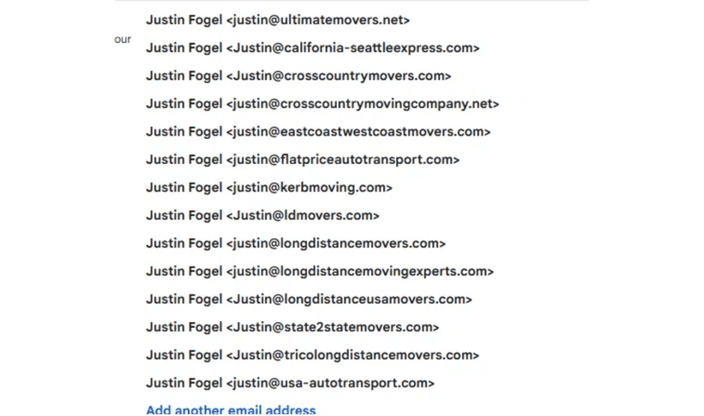
THE FTC FINE PRINT
The FTC does NOT ban incentivized reviews — it bans incentivized POSITIVE reviews.
"The Rule does not prohibit giving incentives for reviews, as long as there is not an express or implied requirement that the reviews have to express a particular sentiment." — FTC Rule (Oct 21, 2024)
✗
PROHIBITED: Saying "tell us how much you loved your move."
✗
PROHIBITED: Review Gating (routing happy customers to public sites, unhappy to private).
PROTECTING THE PORTFOLIO ACROSS ALL BRANDS
✓
COMPLIANT: Sending a satisfaction survey FIRST, then sending ALL respondents a review request.
PENALTY FOR VIOLATIONS: $53,088 PER INCIDENT
Source: National Law Review, FTC 16 C.F.R 255.5

Slide 6

THE PLAYBOOK
7 strategies that stay within the lines but maximize review generation
01
The Two-Step Decoupled System
02
Own-Site Testimonial Engine
03
Google Review Solicitation
Gift card for a survey (not a review); follow up with a non-incentivized review request.
Offer $15 for testimonials on our WordPress sites with clear disclosure.
Send a short text/email with a direct Google review link within 24 hours. No incentive.
04
Video Testimonials
05
Blog Story Interviews
06
BBB Review Requests
Record willing customers and post on YouTube; embed on sites for extra visibility.
Interview customers and publish editorial-style posts—different from "reviews."
Solicit reviews via BBB—high authority and allowed by their policies.
07
Reddit Authority Building
Build expert presence on Reddit (90/10 rule) that AI engines reference—not direct reviews.

Slide 7

THE AGENT ARCHITECTURE
A 4-stage automated pipeline from move completion to public review
1
2
3
4
TRIGGER
SATISFACTION
ROUTING
FOLLOW-UP
Move is marked as "Complete" in the CRM system.
Automated text sent via existing system.
ALL customers get review links (Google + Own-site) and gift card offer.
If no review is posted after 3 days, one follow-up is sent.
Customer is asked to rate their experience from 1 to 10.
This initiates the automated sequence without manual intervention.
Unhappy customers (1-6) ALSO get an escalation message to customer service.
Sequence then stops to prevent spamming the customer.
!
CRITICAL COMPLIANCE POINT: ALL customers get the same review request regardless of their satisfaction score. No review gating. This ensures 100% FTC compliance.

Slide 8






THE MULTI-BRAND ENGINE
One system, 19 brands, 100+ locations — here's how it scales.
Brand-Specific Pages
Location-Specific Links
Smart Routing
Each brand has a dedicated review landing page on its WordPress site.
The agent picks the correct brand & location link from the CRM record.
Google review links are mapped to each Google Business Profile location.
Centralized Dashboard
Automated Reporting
Spam Prevention
One dashboard tracking volume, sentiment, and response rates across brands.
Monthly summaries: reviews, average ratings, response times, and gift cards.
Coordination ensures customers receive a single consolidated request.

Slide 9

COMPETITOR ANALYSIS
International Van Lines is gaming the system. We are building an asset.
THE COMPETITOR
OUR STRATEGY
THE REALITY
THE REALITY
A 1.5-star rating across 1,600+ Yelp reviews. Poor actual customer satisfaction.
19 distinct brands with 100+ locations ready to capture genuine customer satisfaction at scale.
THE TACTIC
THE TACTIC
Paying for artificial manipulation on Forbes and Grok to bury negative real-world feedback.
An automated, 100% FTC-compliant pipeline that turns actual happy customers into public advocates.
THE RISK
Highly vulnerable to FTC crackdowns ($53k per violation) and AI algorithm updates. It is a fragile house of cards.
THE ADVANTAGE
Builds permanent, unshakeable entity authority that AI engines trust organically. Zero legal risk.

Slide 10
ESTIMATED COSTS AND ROI
The Math: Low overhead, high leverage
INVESTMENT
PROJECTED 90-DAY ROI
Agent Build & Integration
$2,500
300+
15%
One-time setup (CRM, Twilio, Routing)
New Authentic Reviews
Local SEO Visibility Bump
Software Infrastructure
$150 / mo
Monthly (Zapier, Twilio SMS, Hosting)
Distributed across the 19 brands and 100+ Google Business Profile locations.
Consistent review velocity is the #2 ranking factor for the Google Local Pack.
Gift Card Budget
Pay for Performance
Variable ($15 per completed survey)
AI Dominance
The Ultimate Goal
High review volume feeds directly into ChatGPT and Perplexity recommendations.

Slide 11

30-DAY IMPLEMENTATION TIMELINE
From approval to first automated review in 30 days
W1
W2
W3
W4
ARCHITECTURE & API
LOGIC & TEMPLATES
WORDPRESS INTEGRATION
TESTING & GO-LIVE
Connect CRM to Agent
Build 1-10 routing logic
Build 19 brand landing pages
End-to-end dummy testing
■
■
■
■
Map all 100+ GBP locations
Draft FTC-compliant copy
Final compliance review
■
■
■
Implement disclosure text
Set up gift card API
■
Turn on the agent
■
■
Set up Twilio/Email gateways
Set up tracking dashboard
■
■
MONTH 2 & BEYOND
Once the Review Agent is live, we shift focus to the Social Media Automation Pipeline and AI Sales Assist, running concurrently while reviews generate on autopilot.

Slide 12

THE BOTTOM LINE
We have the portfolio. We have the strategy. Now we need the engine.
100% COMPLIANT
FULLY AUTOMATED
DIRECT ROI
Zero legal risk. Fully aligned with FTC regulations and Google's latest policies.
Runs silently in the background across all 19 brands and 100+ locations.
More reviews = higher AI visibility = more booked moves.
NEXT STEP
Approve the implementation budget to begin Week 1 on Monday.

